Slide 1
Database linking tables (relationships)
Guide 05

Slide 2
Important to link tables
Important to link the data together to "enforce referential integrity"
This means data has to exist in both tables and makes it better and more valid data and stops redundancy

Slide 3
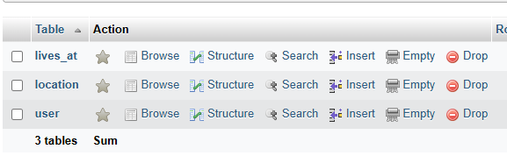
Index the foreign key columns
For each column you want to link, you HAVE to index the column
Click "structure" on each table, with a column you want to link.
If its already a primary key, you don’t need to do this

Slide 4
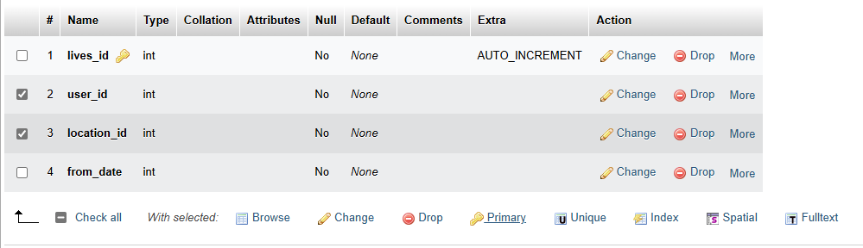
On each column
Check the tick box
Click index

Slide 5
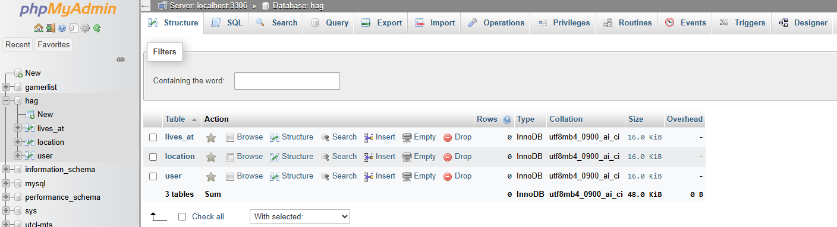
Access the designer
Access designer to link the tables

Slide 6
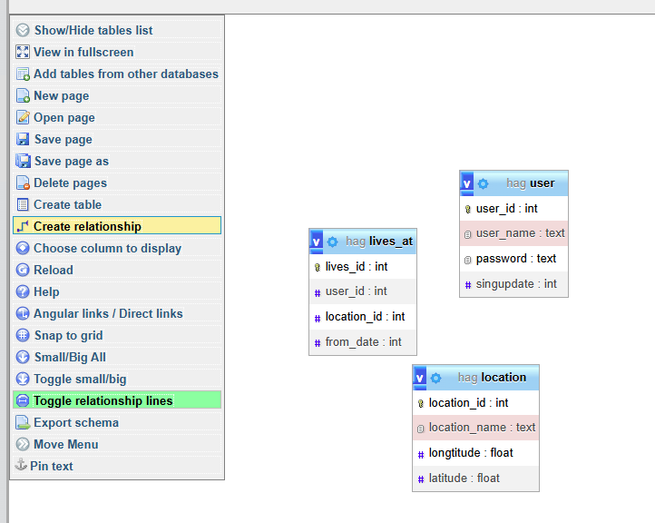
Establish the links
Arrange the tables as you want
Click "Create relationship"

Slide 7
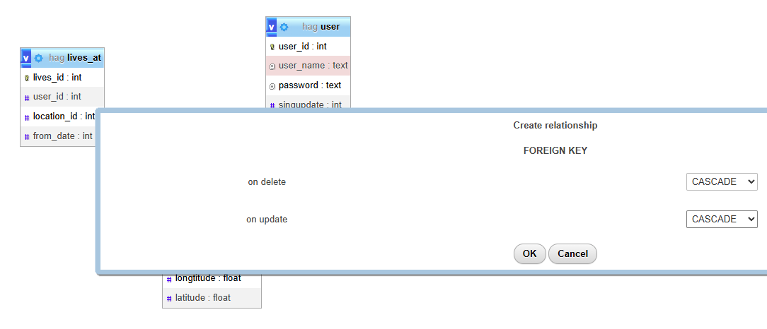
Click the columns you want to link
Click on each of the 2 cols to link, and this box appears:
Choose "cascase" on each drop down (important to choose this)

Slide 8
If you get an error...
Then either: You havent indexed the columns OR they are not the correct data types (int / text etc, they have to match to build the relationship)

Slide 9
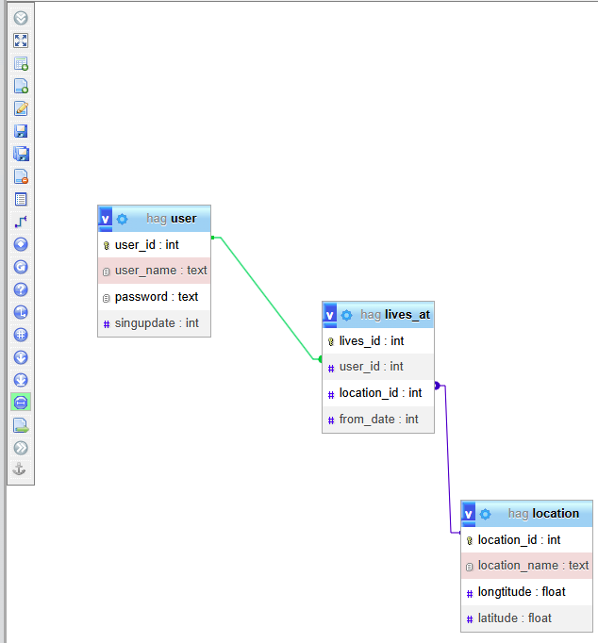
Repeat
This process for each relationship in your database

